Slide 1


Equal Pay Registration Certification
Updates
​
October 2026
DOL.EPRC@illinois.gov
Hotline Phone 312-793-6797

Slide 2
About Illinois Department of Labor
Charged with enforcing laws protecting workers’ rights on the job.​
With offices in Chicago, Springfield, and Marion, IDOL enforces about 30 different workplace protections and safety standards. ​
One of the laws IDOL enforces is the Illinois Equal Pay Act of 2003 ("IL EPA"), which prohibits employers from paying people differently based on sex or race (African-American) for doing the same or substantially similar work in the same county.
IDOL cannot provide legal advice. Employers should consult their legal counsel to determine their duties under the law.

Slide 3

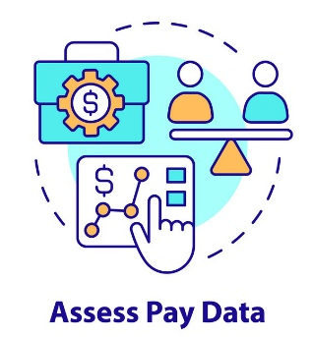
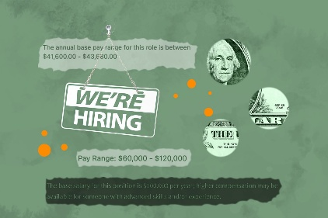
Illinois Equal Pay Act Programs
Individual action (2003):
Complaints about pay disparities due to gender, request for job applicant salary history, ban on discussing pay, and intimidation/interference with - or retaliation for - asserting equal-pay rights.
Complaints about pay disparities based on African-American race (2019).
Ban on asking applicants about salary history (2019).
Comprehensive view (2022):
  Equal Pay Registration Certificate (“EPRC”) pay data reporting, mandatory 3/2024.
    Private businesses with 100+ employees in Illinois must submit application to obtain an EPRC by providing certain pay, demographic, and other data to IDOL every two years.
Leveling playing field for jobseekers (2025):
  Pay Transparency and Promotional Opportunity for job postings by employers of 15+ employees.

Slide 4
Overview – Agenda
EPRC Background + Main Takeaways
EPRC after three years
Basics Review, and What is Changing about EPRC?
FAQs – see our website at labor.Illinois.gov
Email: DOL.EqualPay@illinois.gov

Slide 5
Main Takeaways
Employers with 100+ Illinois employees must register for EPRC and obtain certification every two years.
    An employer that obtained certification two years ago must renew registration, and should receive automatic notice through the IDOL portal system.
Registration and certification occur via a designated IDOL online Portal.
There are some updates to the pay data sought in EPRC and improvements to the EPRC system itself.
As of 1/1/2027 EPRC’s Portal will accept only an updated pay data template, and will automatically reject prior versions of the template.

Slide 6

EPRC Statistics

Slide 7
EPRC To Date
In the first three fiscal years since EPRC went into effect:
Over 4800 employers with 100+ Illinois employees have obtained approved EPRC Certifications from IDOL.
With respect to business EPRC submissions, IDOL has:
Approved ≥ 8500
Denied ≥ 700
The number of businesses that have re-certified is over 3,000.

Slide 8
Breakdown by Fiscal Year
FY2022: 260 EPRC registrations submitted; 78 approved and 25 denied.
FY2023: 860 EPRC registrations submitted; 793 approved and 62 denied.
FY2024: 3,175 EPRC registrations approved, 89 denied.
FY2025: 2,439 EPRC registrations approved, 301 denied
NOTE: Many initially-denied registrations subsequently were approved.

Slide 9
Monthly Submissions
EPRC submissions can vary wildly per month, as in some months only a handful of businesses make EPRC submissions and in others 500-1000 businesses submit them.
At this time, there are three staffers in the EPA unit to work on EPRC, and substantive pay disparity complaints, and Pay Transparency.
Typically, only one IDOL staffer works on EPRC at a time.
For each EPRC submission, a staffer must: review the submission for completeness; review the submitted pay data to ensure that it is both readable and valid/complete; find and upload the related filing fee receipt; and update EPRC program information.
Any time a submission is rejected, the staffer must take additional steps to provide information to the business, record the rejection and reason in the EPRC Portal, update EPRC program information, and enter the rejection in a timeline tracker.

Slide 10
Enforcement Efforts
In FY 2024, IDOL began implementing compliance activity designed to encourage employers who had not responded to prior notice about EPRC requirements.
Each employer receives email reminders to obtain EPRC registration 180 days before their EPRC deadline, and then again 60 days before their EPRC deadline.
If not registered, IDOL sends Notice of Delinquency (now Notice of Non-Compliance).
If still not registered, IDOL sends Notice of Violation.
FY2024 Notices of Violation = 15
FY2025 Notices of Violation = 67

Slide 11
Employee Data Requests
IL EPA allows a current employee of an employer required to obtain an EPRC to request anonymized data for their job title or classification.
Requests received to date:
  2022 = 2
  2023 = 13
  2024 = 19
  2025 = 22

Slide 12

EPRC – How Employers Use It

Slide 13
EPRC Process Basics
The process for registering for EPRC
New or changed data elements
New or changed submission/format options
Recertification issues to note

Slide 14
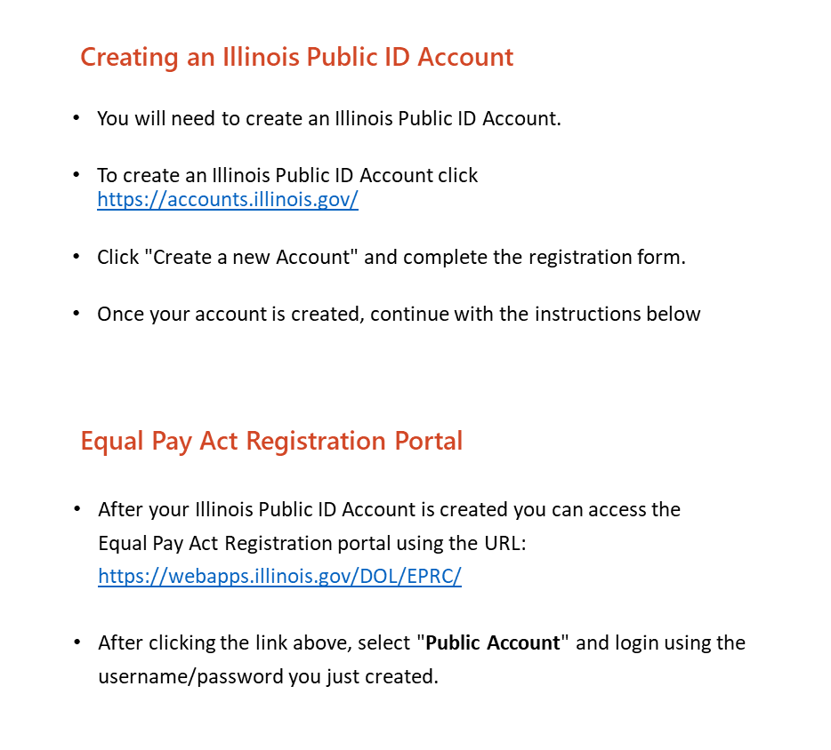
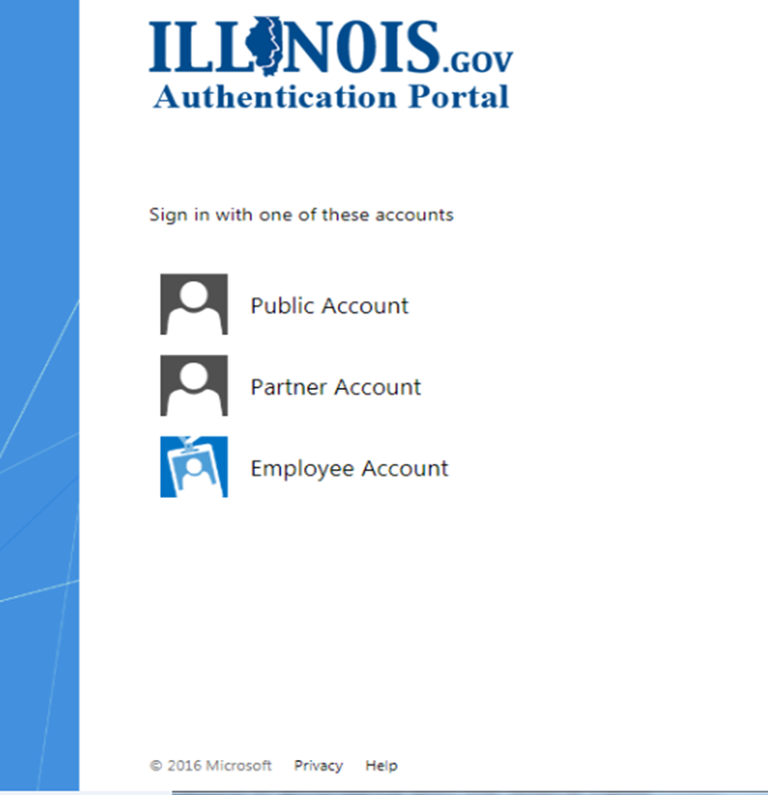
Login Page
1.
2.

Slide 15
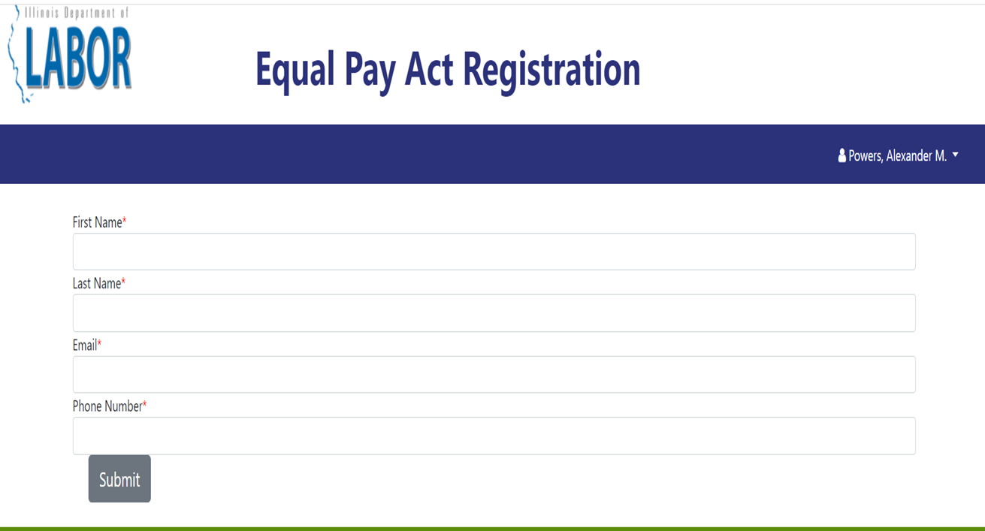


User Registration – First Time Only

Slide 16
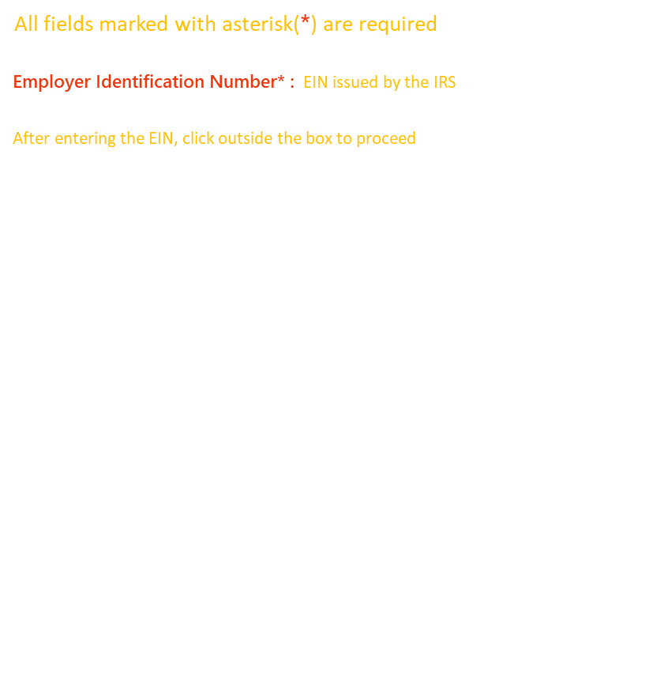
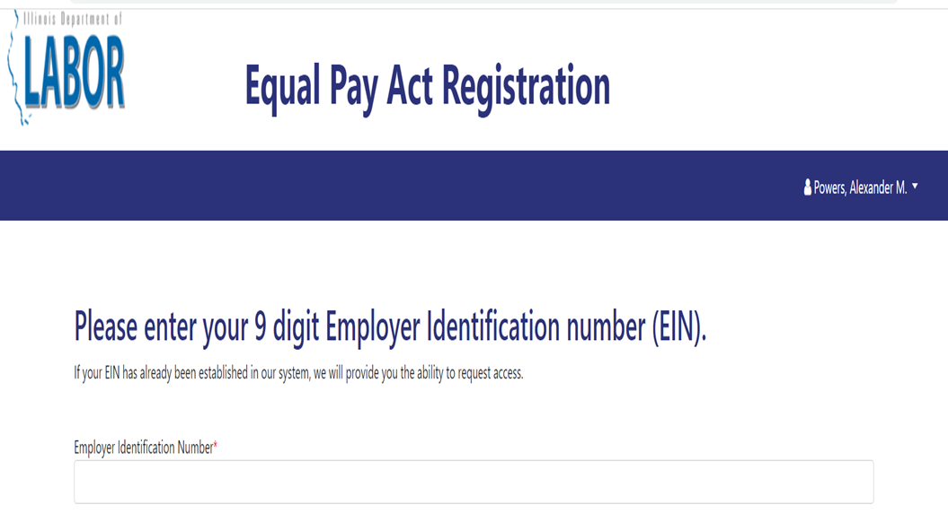

Add a Business – First Time Only
NOTE: Enter only numbers in this EIN field, meaning do not enter the dash that separates some of the numbers.

Slide 17
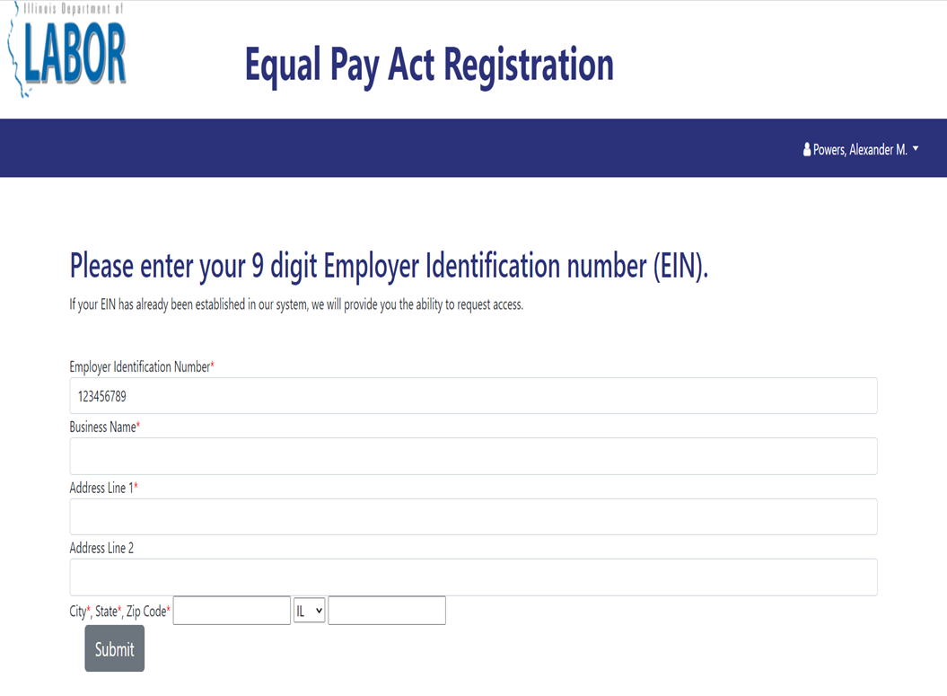
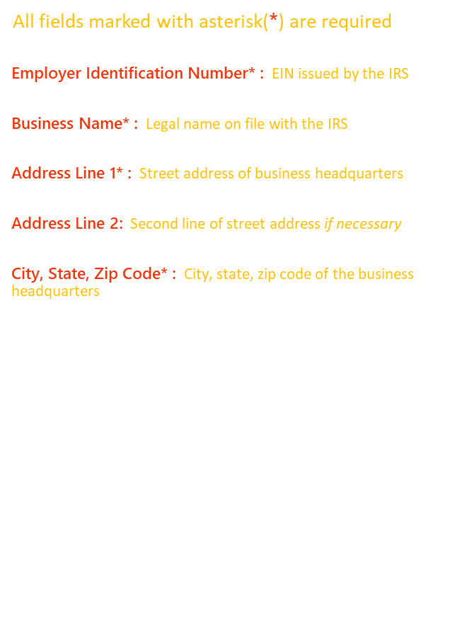
Add a Business (2)

Slide 18

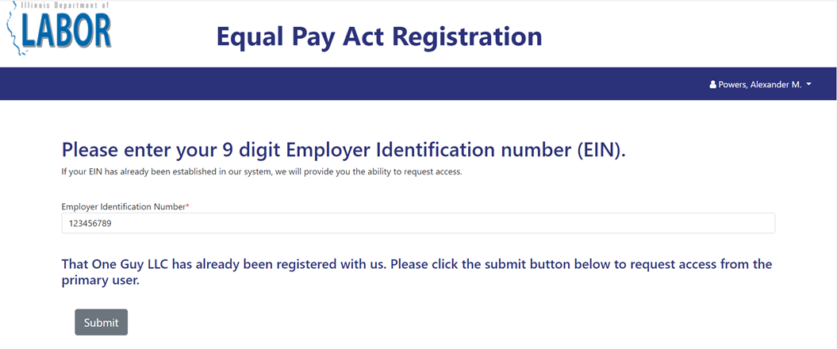
Add a Business (3)

Slide 19

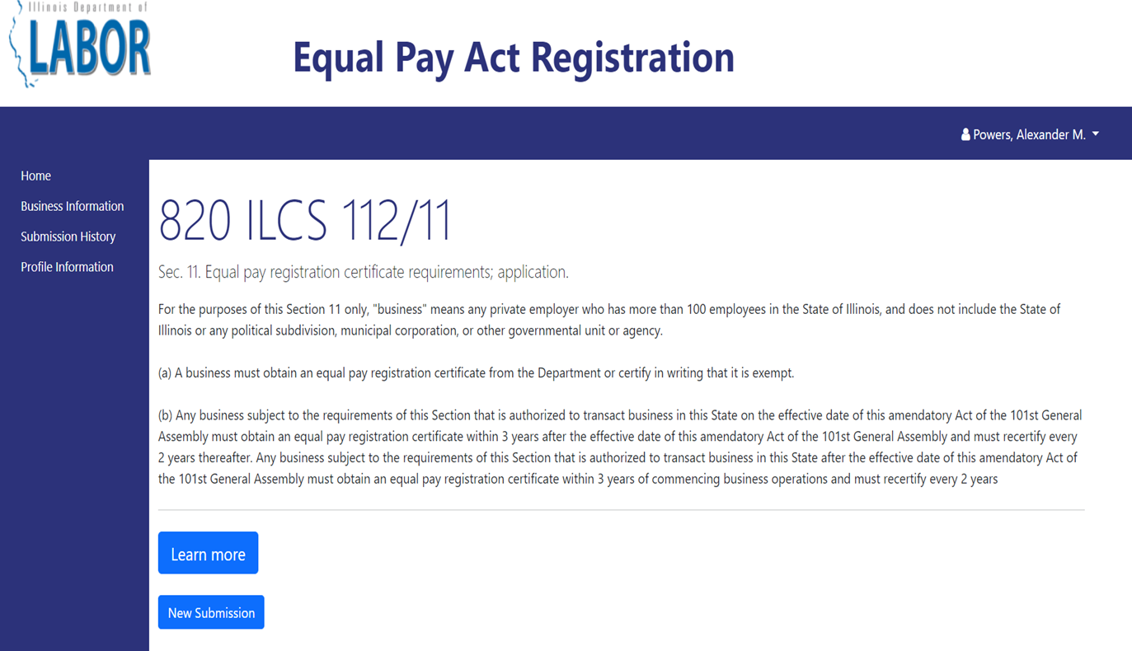
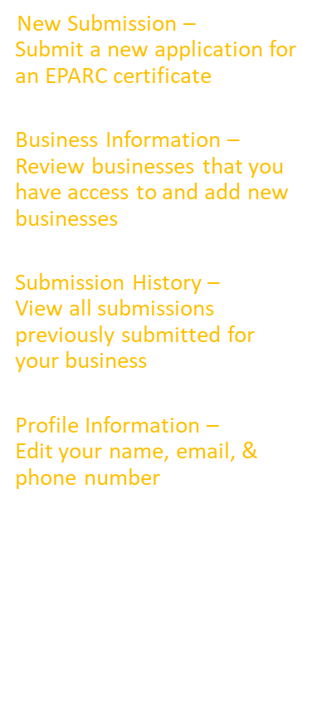
Home Page

Slide 20

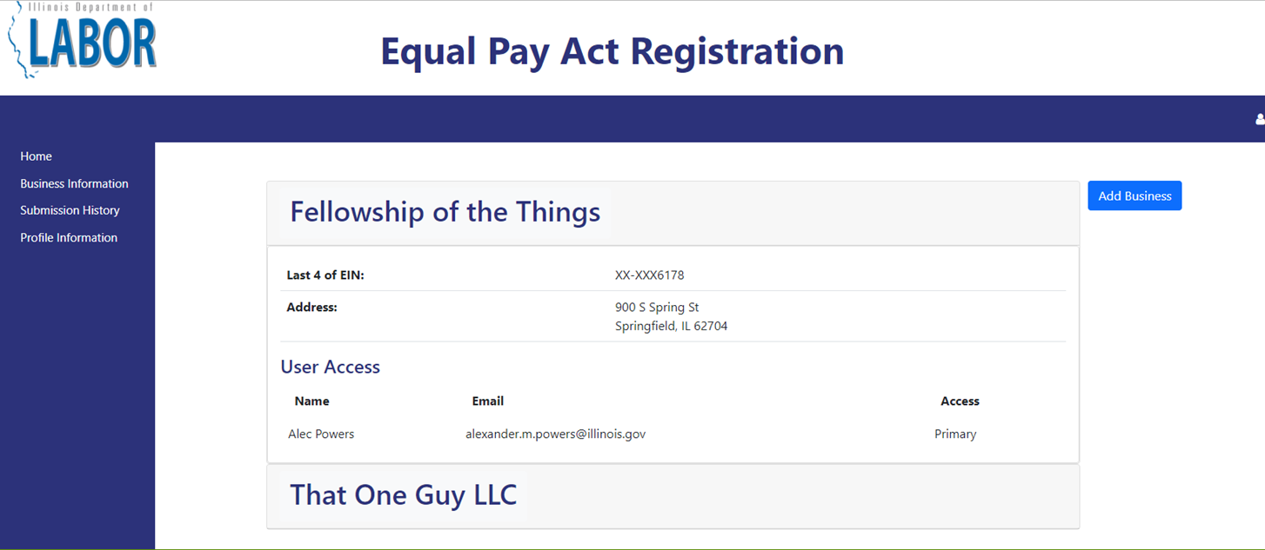
Business Information Page

Slide 21

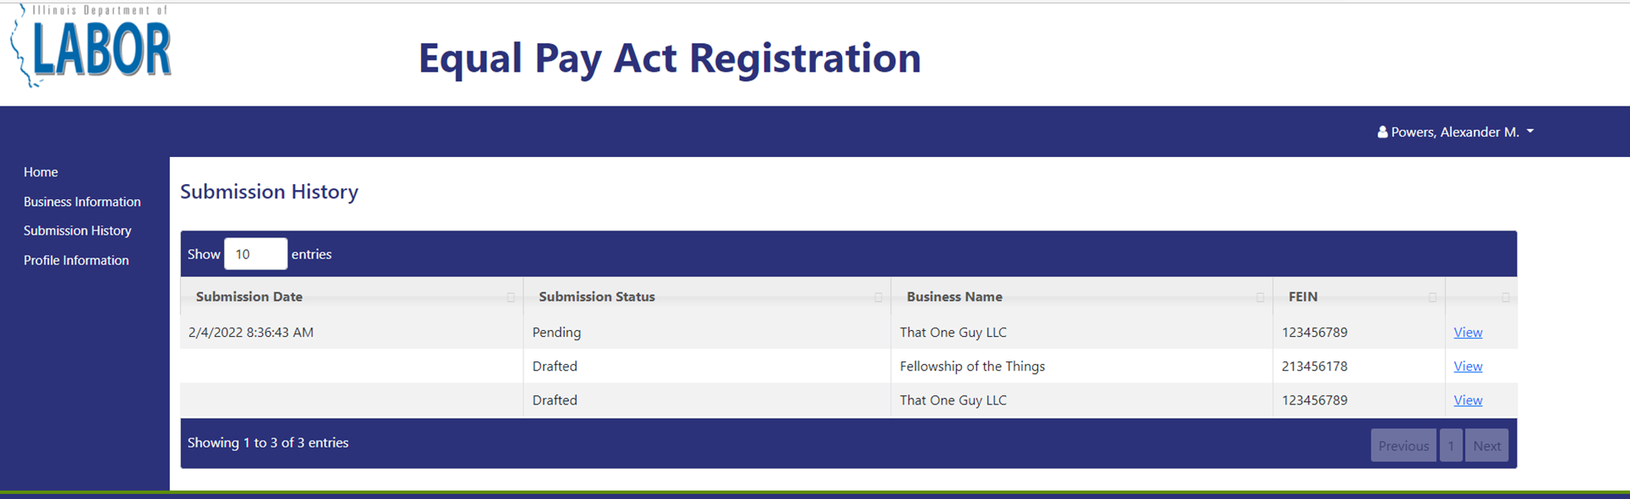

Submission History Page

Slide 22


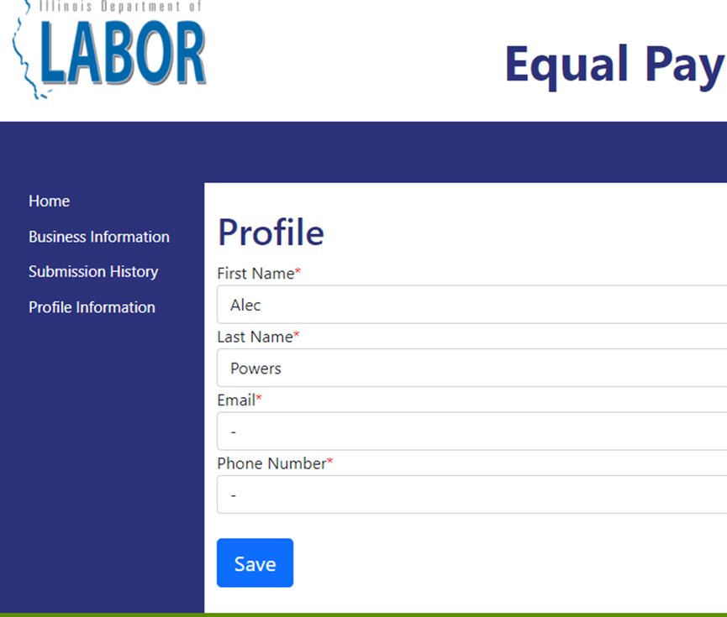
Profile Information Page

Slide 23

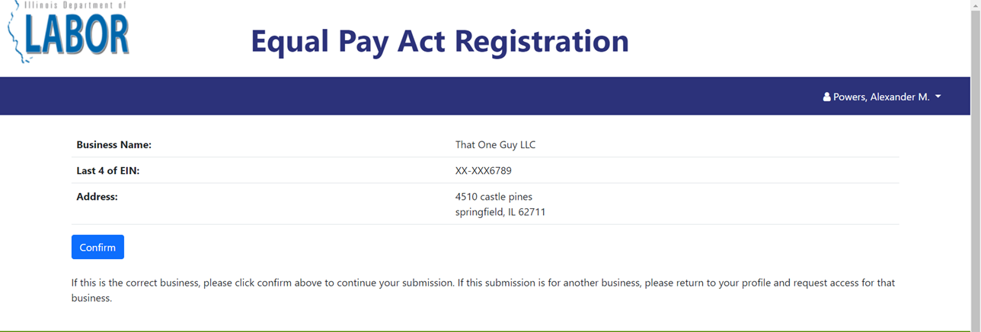
Confirm Business

Slide 24


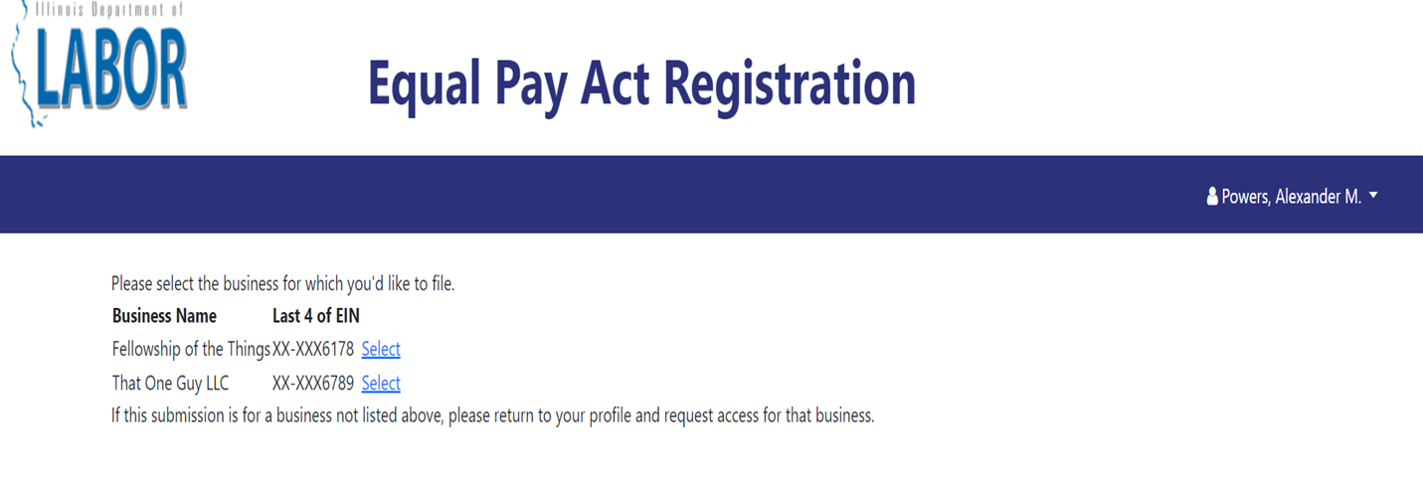
Select Business

Slide 25

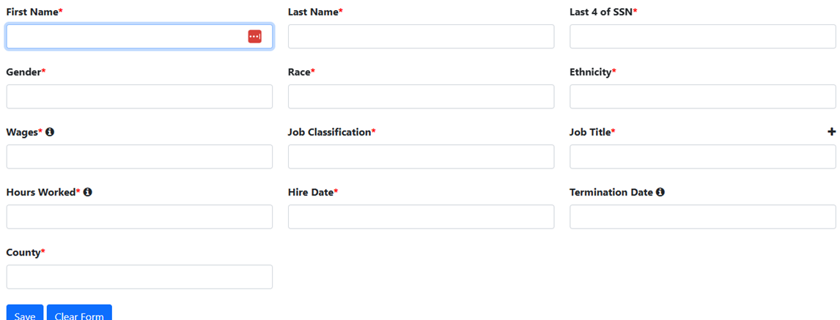
Add Employees
All fields marked with an asterisk (*) are required to be filled out.
First Name: Employee first name
Last Name: Employee last name.
Last 4 of SSN: Final 4 digits of employee’s Social Security Number.
Gender: Employee gender ( “prefers not to identify” no longer available as an option on CSV).
Race: Employee race ( “prefers not to identify” no longer available as an option on CSV).
Ethnicity: Employee ethnicity
Wages: Wages paid in previous calendar year, rounded to the nearest hundredth dollar.
Hire Date: Date employee started in each position, with separate lines for different positions if the employee changed positions during the year.
Termination Date: Date employee stopped working in this position, for any reason (resignation, promotion, etc).
Job classification means one of these job categories: executive/senior-level officials and managers, first/mid-level officials and managers, professionals, technicians, sales workers, administrative support workers, craft workers, operatives, laborers and helpers, and service workers.
Job Title: Payroll title for the employee’s position.
Hours Worked: Total hours worked by that employee in the position, with separate lines for different positions if employee changed positions during the year.
County: Illinois county in which employee performs the majority of their work.
Hourly v. Salary: Whether the employee was paid on an hourly or a salaried basis.
Hourly Rate: If the employee was paid on an hourly basis, their base hourly rate.
CBA Yes or No? Was employee covered by a collective bargaining agreement? (Y) or (N).

Slide 26
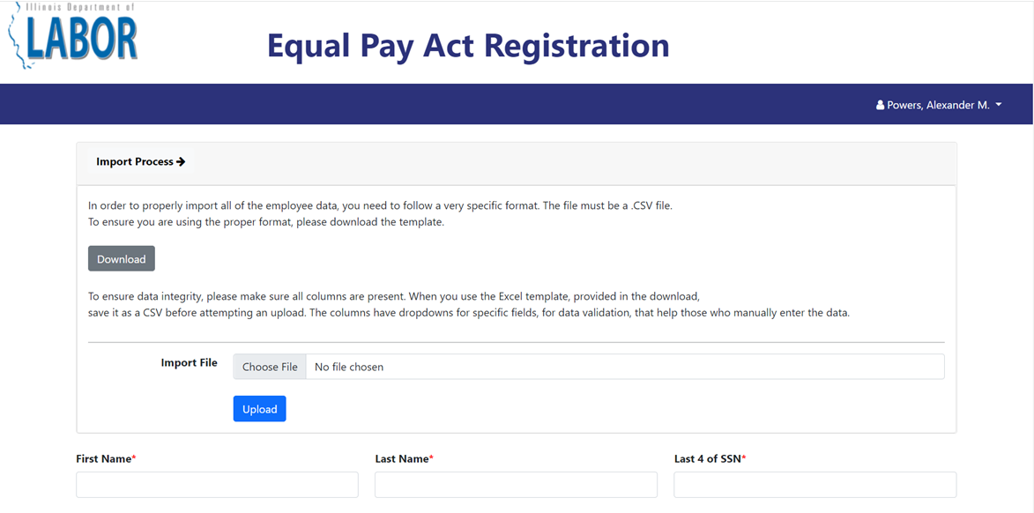
Full Import Process (1)
The full import process allows you to upload all of the required fields with a CSV file. You can download the template.
Requirements:
CSV File
Follow Template’s Column Names
Data in appropriate format
(See Template)
New Template required as of 1/1/2027

Slide 27
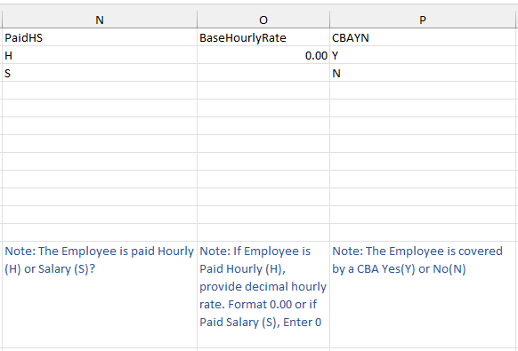
Full Import Process (2)
The full import process allows you to upload all of the required fields with a CSV file. You can download the template.
Requirements:
CSV File
Follow Template’s Column Names
Data in appropriate format
(See Template)
New Template required as of 1/1/2027

Slide 28
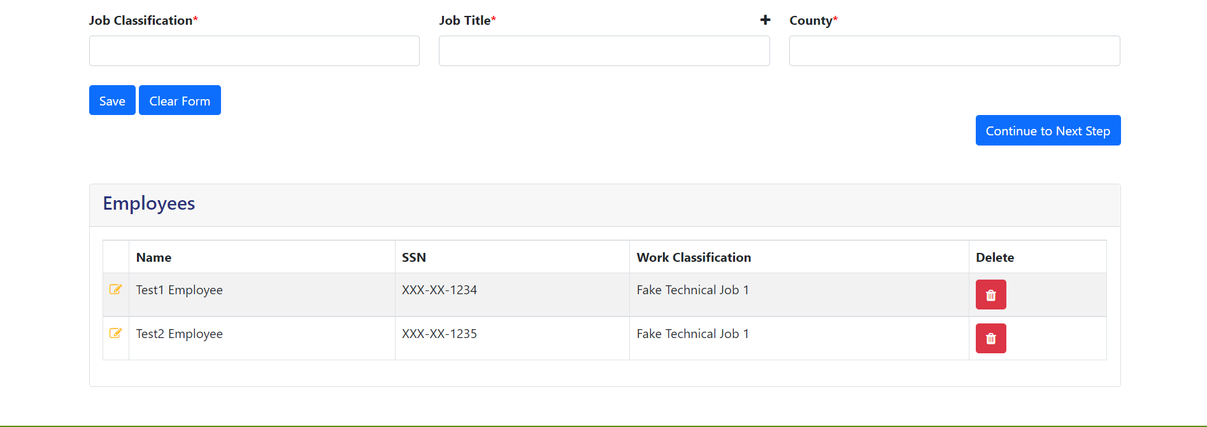
Saved Employee Details
At the end of the page, we can see the saved employee details ​
Click on to edit or view the employee details ​
Click on Continue to Next Step to proceed​

Slide 29
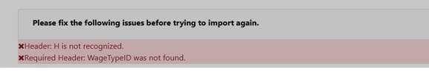
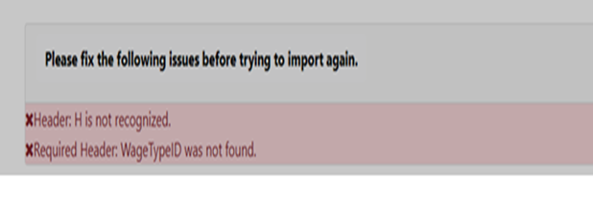
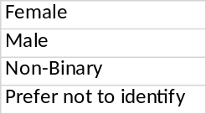
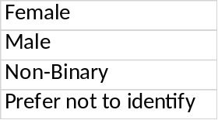

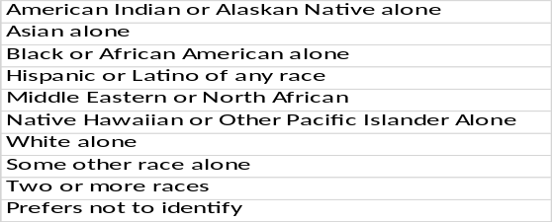
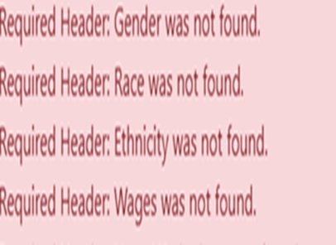
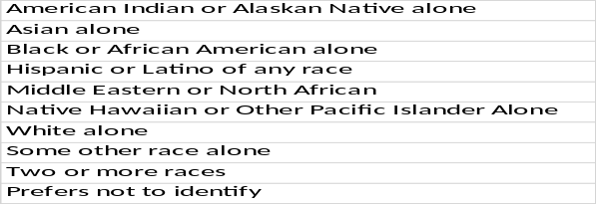
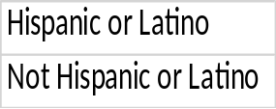

Common Data Upload Errors
Data Type | Error Message Looks Like | Cure | Looks like
Header |  | Header: copy and paste data into IDOL-provided template.
Gender |  | Gender must match exactly one of template options.
Race |  | Race must match exactly one of template options.
Ethnicity |  | Ethnicity must match exactly one of template options.
Wage/Hour |  | Wage/Hour should be reporting a full year’s wages and worked hours. Use Box 5 from W-2. Use numeric data rounded only to nearest hundred dollars (no cents, decimals, or $ sign).
Header
Gender
Race
Ethnicity
Wage/Hour
To fix header, copy and paste data into IDOL provided template.
To fix entry on gender, must exactly match one of template answers:
To fix entry on race, must match exactly one of template answers:
To fix entry on ethnicity, must match exactly one of template answers.
To fix wage/hour entry, reort full year wages, use box 5 of W-2, numeric

Slide 30
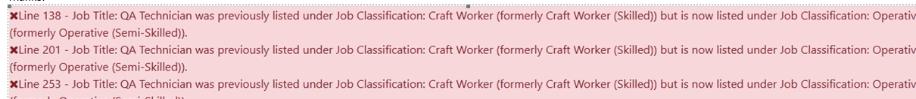
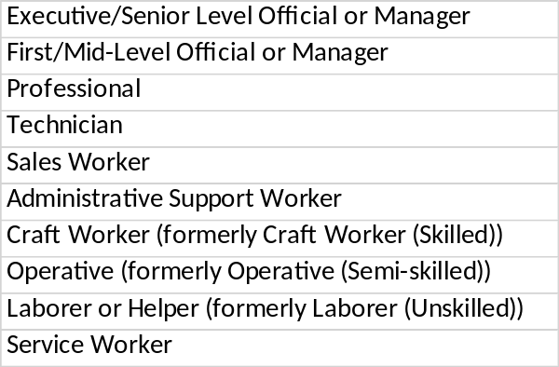

Common Data Upload Errors (2)
Data Type | Error Message Looks Like | Cure | Looks Like
Job Classification |  | Each unique job title can only be assigned in one job classification. Job classification name must exactly match one of the template options (not one of the entries you made in a prior year’s submission).
Paid Hourly or Salary |  | Answer can only be H or S
Base Hourly Rate |  | If employee is hourly, enter base rate in 00.00 decimal format, do not use $ signs. If employee is salaried enter 0.
Collective Bargaining Agreement (CBA)? |  | CBA answer is only Y or N
Job Classification Error
Paid HS Column
Base Hourly Rate Column
CBA ( Collective Bargaining Agreement) Column

Slide 31
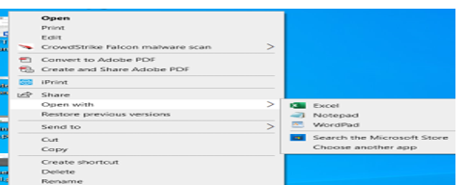
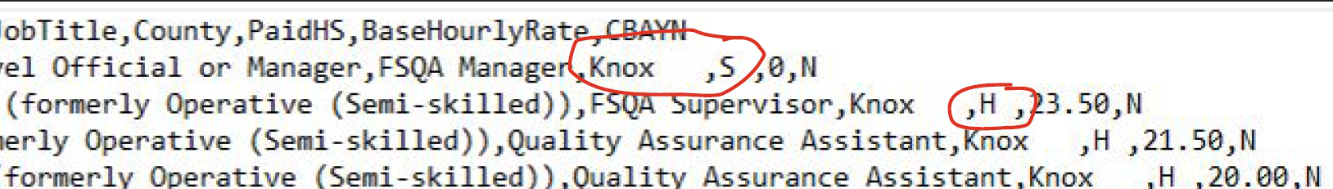
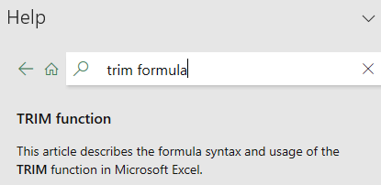
Other / Hidden Errors
Before uploading data, can users identify other errors not immediately visible in the Excel file??
YES, by opening the .csv file in notepad format and inspecting the entries closely.
Step 1: To review the .csv file in notepad version, locate the saved file.
Step 2: Before opening, right click on the file, choose Open With > Notepad.
Step 3: Review each line entered closely to find any spacing or comma errors,
which cause the data to upload incorrectly.
These errors are typically extra spaces and/or extra commas: such as ,H , in the PaidHS column instead of ,H,
This example file has spaces after Knox in the county column, and a space after each H or S in the PaidHS column.
The cure for these errors:
1. Manually clear the column, and then manually enter or paste just the text data.
2. There is also a TRIM formula that can be used.
(Search “Trim Formula” in Excel Help.)

Slide 32

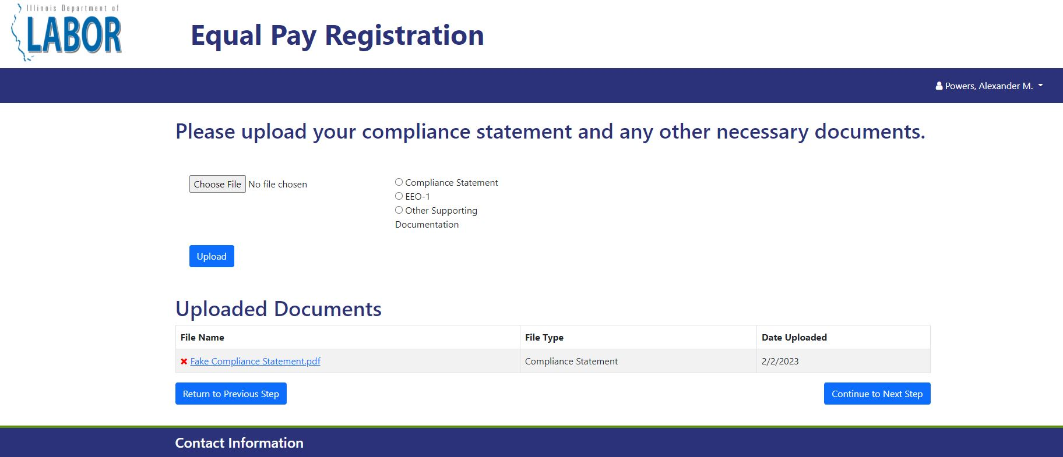
Required Documents
You must submit one additional document.
The business must file a compliance statement.

Slide 33
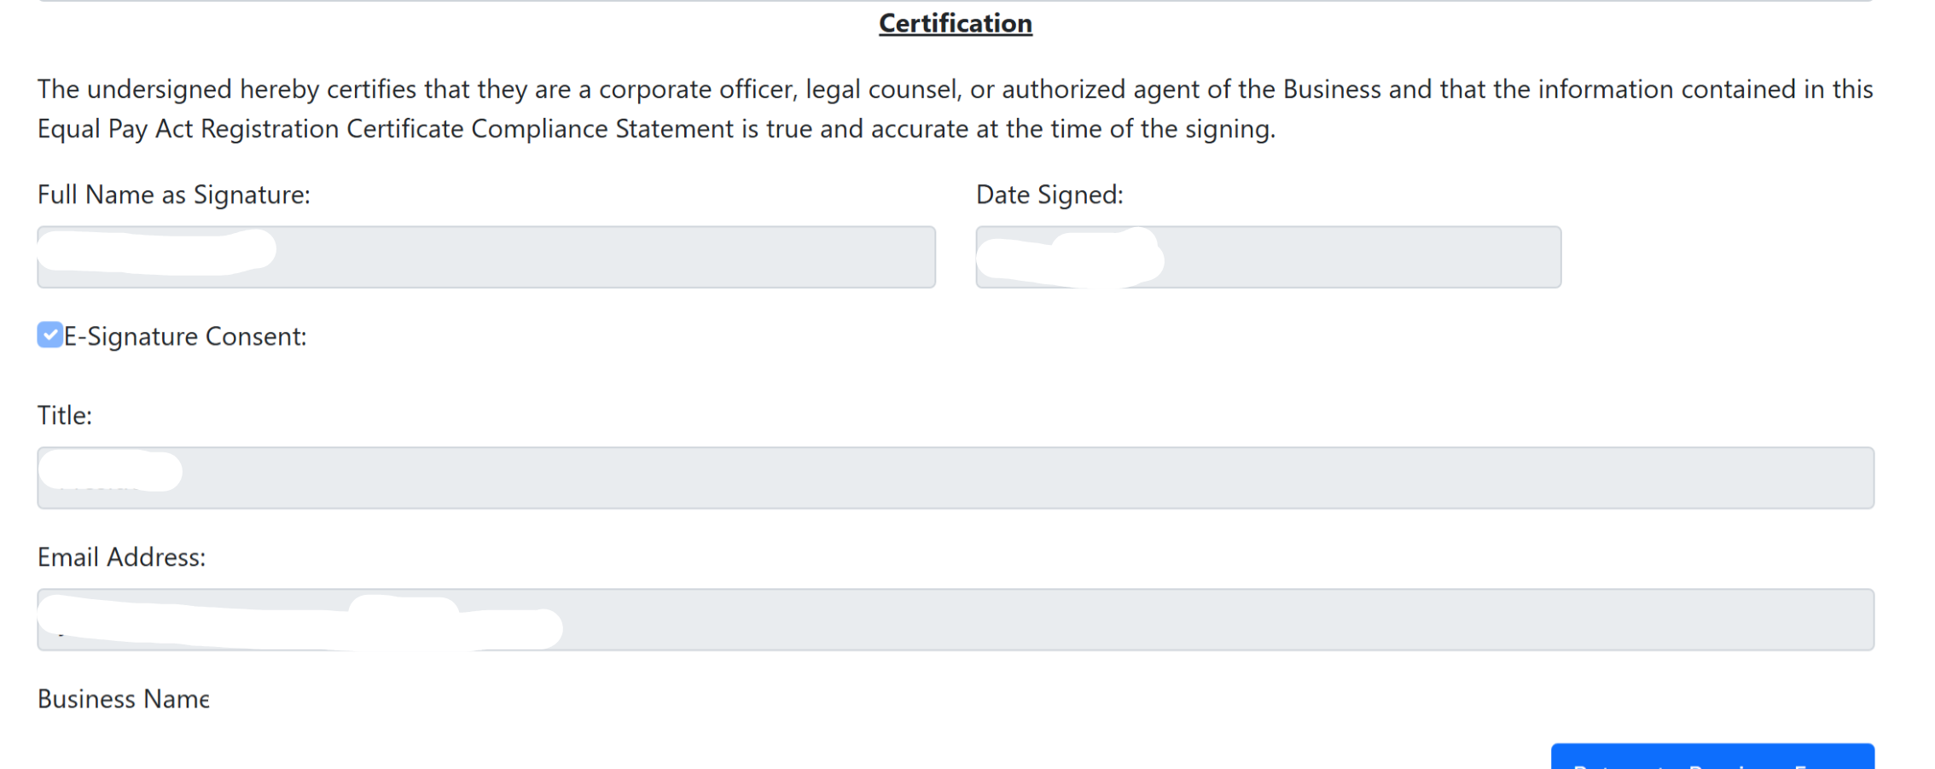
Compliance Statement
Before 8/2025, the business had to download, print, sign and attest, and then upload a form into the EPRC Portal.
Now, it is a fillable form that is part
of the EPRC Portal process.
NOTE: If the person completing a business’s EPRC submission in the Portal is not an official who can certify the business’s Compliance Statement, the business can upload a signed Compliance Statement in the EPRC Portal in addition to its web-based submission.

Slide 34
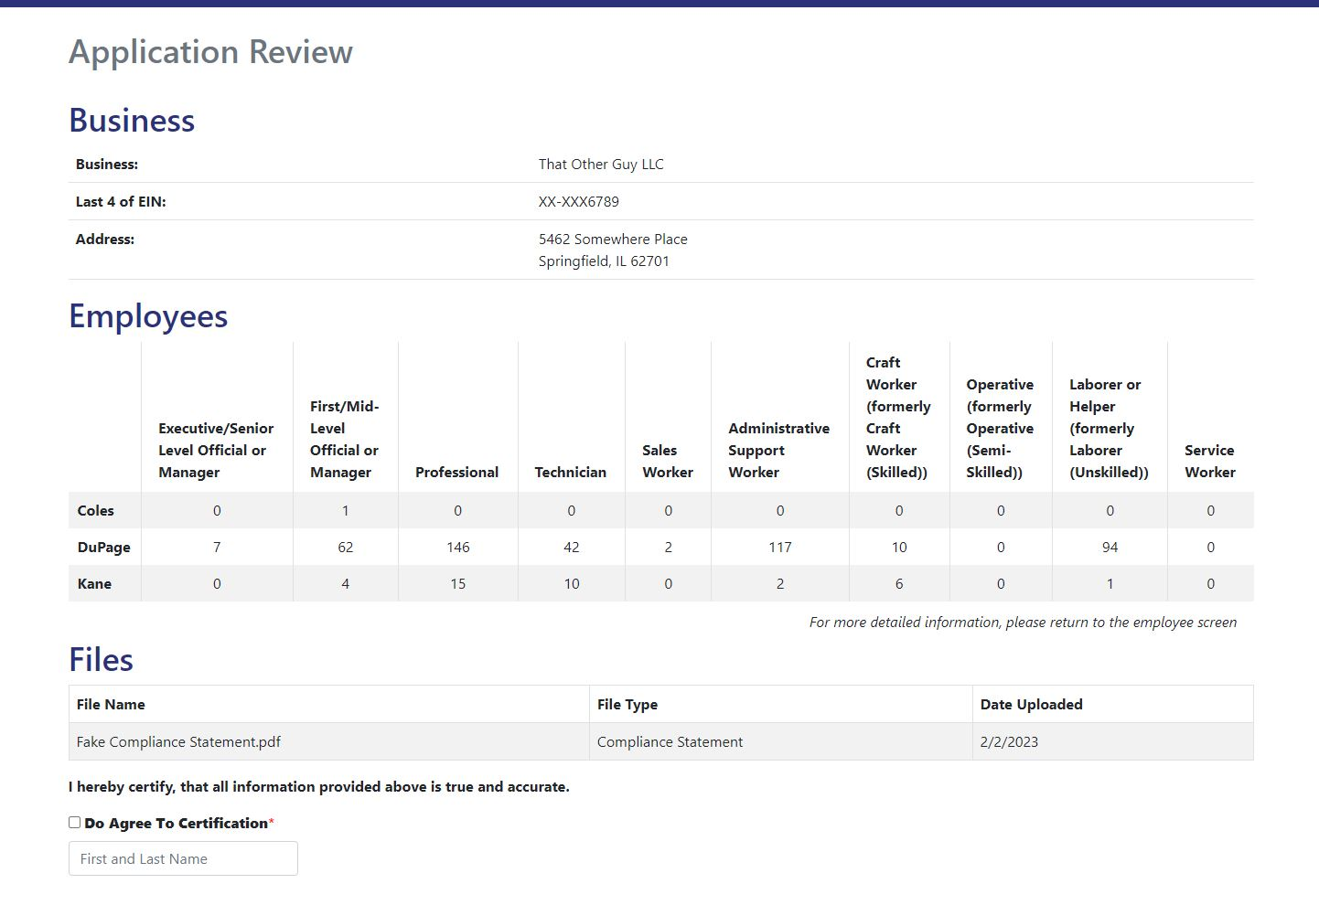
Review Page (1)

Slide 35
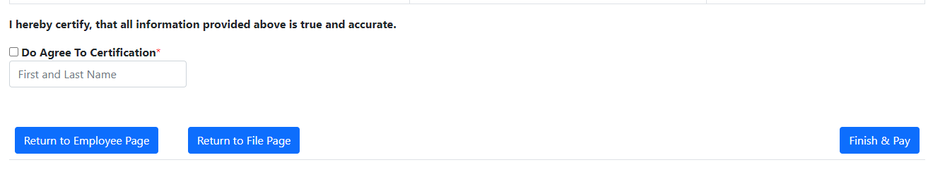
Review Page (2)
Click the box for "Do Agree To Certification"
Then
Enter the First Name (Space) Last Name to certify the certificate​
Then if needed
Click on previous button to go back to previous screens ​
Then
Click on Finish & Pay to proceed

Slide 36
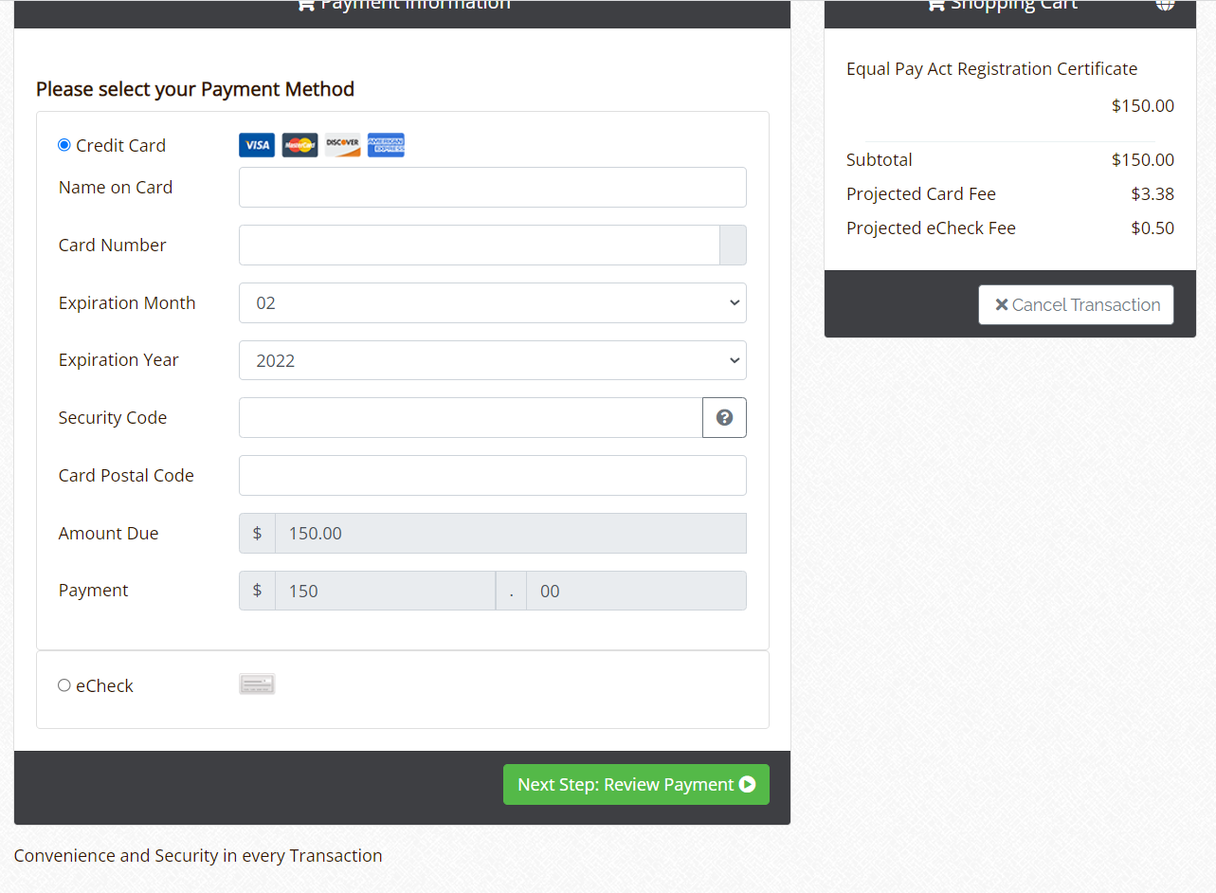
Payment
(1)

Slide 37
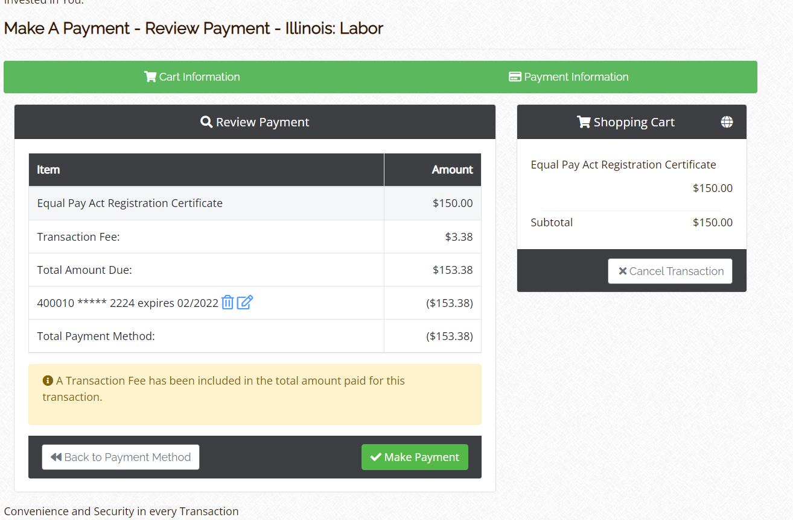
Payment
(2)

Slide 38
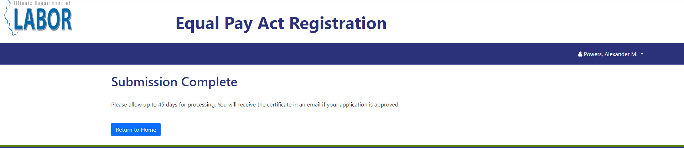
Confirmation Page
An email will be sent with the same information to the user that submitted the application and the user that first registered the business (if they are different users)

Slide 39
Recertifications
As recertifications begin, a few portal and data updates.
Also, some error flags you may see when recertifying:
Employer changed the entity name from its original registration
Contact person in the system is no longer at employer
NOTE: EPRC staff do not see changes that the employer has submitted, so may not know why an error message has arisen without significant investigation.

Slide 40
1/1/2027: New CSV form for Employee Data
With an increasing number of businesses reporting many of their employees' race or gender as "prefers not to identify" in EPRC pay data, IDOL has rejected EPRC submissions that denote a significant percentage of employees' race and gender as "prefers not to identify", as the absence of accurate race and gender data impedes our ability to enforce the IL EPA in a meaningful way.
The EPRC pay data template on IDOL’s website no longer contains a "prefers not to identify" selection for employee race or gender.
Until 1/1/2027, if IDOL does receive a submission that includes "prefers not to identify" selections for significant numbers of employees' race or sex, IDOL will address it with that business.
As of 1/1/2027, IDOL will make available – and require businesses to use for EPRC submissions – a new CSV that does not include "prefers not to identify" as an employee gender or race demographic option; our back-end systems will reject any CSV that denotes an employee’s gender or race as "prefers not to identify".

Slide 41
Questions and Comments
Q&A: Send questions to All Panelists
We may not be able to get to all questions, and appreciate your patience!
Slides and FAQs will be available:
https://labor.illinois.gov/laws-rules/conmed/eprc.html
DOL@EPRC@illinois.gov
Hotline Phone 312-793-6797

